Slide 1
Bradley Beach Board of Education
2023-2024 Budget Presentation
Tuesday May 2, 2023

Slide 2
Bradley Beach Board of Education 2023-2024 Budget Timeline
March 16: Preliminary Budget Adoption
March 29: Executive County Superintendent Approval
May 2: Public Hearing

Slide 3
The 2023-2024 Budget Provides
Rigorous academic programs based on the New Jersey Student Learning Standards
Robust Professional Development opportunities for the staff, including summer institutes
Continued investment in research-based, educational best practices
Staffing and resources to support English Language Learner and Special Education communities
Continued support of Gifted and Talented Enrichment Program
Use of PEA funding to support full-day preschool classes
Continued funding to support the District’s Technology including online instruction and assessments
Providing educational resources for curriculum areas such as Science, English Language Arts, and Mathematics
Support of facility maintenance and improvements including updates to the second floor

Slide 4
The 2023-2024 Budget Provides (continued)
Additional Resources to support districtwide Social and Emotional Learning Programs
Commitment to the continued support of best practices in Mathematics
Development of updating of curriculum as mandated by NJSLS, NJ State Code, and New Jersey Quality Single Accountability Continuum Requirements
Staged Implementation of College and Career Readiness Program for Middle School Students
Funding of first year priorities in the new Strategic Plan
Commitment to the use of benchmark assessments to utilize data to monitor student achievement
Allocates staffing in the support of Reading Intervention
Although there will be an increase in current class sizes at some grade levels, maintains “small” Class Sizes
Maintains Home School Liaison Position (part time)
Maintains Field Trips
Maintains all athletics and arts program

Slide 5
Major Factors Impacting the School Budget
Legislation Impacting 2023-2024 Budget
  Tax Levy Cap (Limits the increase in the tax levy to 2%)
  NJ Senate Bill 2 (S2) FY 23-24 is year 6 of a 7 year phase in
  NJ Senate Bill 3732 (Fiscal Year 2023 Supplemental Stabilization Aid)
  Federal Stimulus funds ending September 2024

Slide 6
Major Factors Impacting the School Budget
Declining Enrollment
ESSER Grants Ending
  Many Positions in Grant needed to move out of grant into general fund to prevent “cliff” in 24-25
  Move some positions moving out of the grant include:
    Technology specialist, class aides, the Basic Skills teacher, one of our interventionists (multiple certifications and is bilingual), part of guidance counselor
Inflationary times affect on Fixed Costs
  Salary 3.55% Salary Increases
  Tuition (HS) Increases
  Benefits (Health Insurance/Property/Workers Compensation)
  Supplies / Materials / Subscriptions

Slide 7
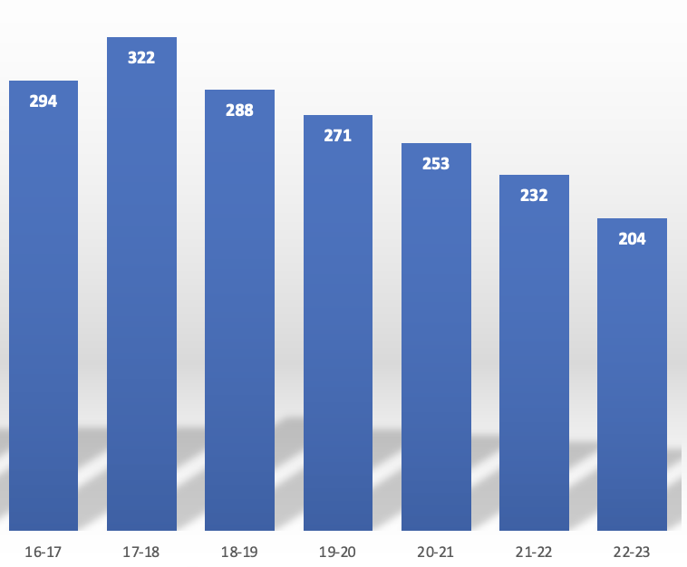
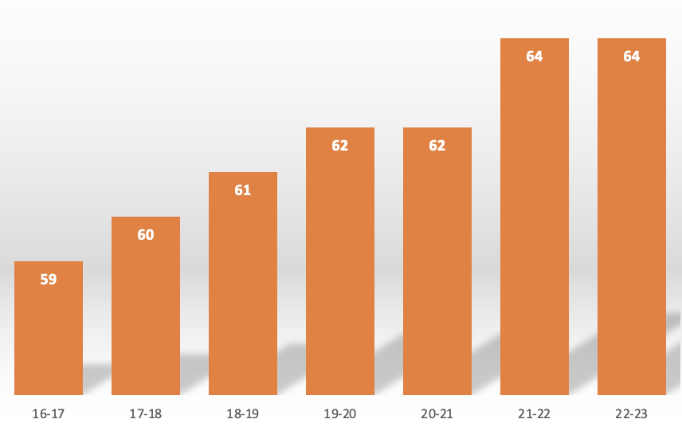
Major Factors Impacting the School Budget
Enrollment Vs. Staffing

Slide 8
Major Factors Impacting the School Budget
Cuts to Supply and other Budget Lines
“Right-Size” the staff for current enrollment
Create Healthy Class Sizes
  Research definitely shows that “small” class sizes positively impact student achievement - but “small” class size studied is usually 15-22 students.
Continued Low Student to Teacher Ratio
  BBES Student - Teacher Ratio 7:1 (State Average 12:1)
Staffing is large part of the budget
  Impact on Budget from salary, benefits, etc.
    Eliminate Non- Instructional and Instructional Positions

Slide 9
General Fund Revenues
 | 2022-2023 Revised Revenues (as of 2/1/23) | 2023-2024 Proposed Revenues
State Aid | $581,139 | $461,097
Fund Balance | 370,085 | 391,838
Withdrawal Maintenance Reserve. | 0 | 0
Withdrawal Capital Reserve | 0 | 0
Unrestricted Miscellaneous Revenue | 14,750 | 14,750
Tuition From Individuals | 15,250 | 15,250
Adjustment for Prior Year Encumbrances | 33,526 | n/a
Tax Levy | 6,575,110 | 6,706,612
Total General Fund | $7,589,860 | $7,589,547

Slide 10
General Fund Balance
In essence the Board’s Savings Account
Limited by law to the greater of $250,000 plus allowable adjustments or 2% of the general fund budget plus allowable adjustments
Fluctuates from year to year

Slide 11
General Fund Appropriations
 | 2022-2023 Revised Appropriations (as of 2/1/23) | 2023-2024 Proposed Appropriations
Total Current Expense | $7,547,198 | $7,566,885
Total Capital Outlay | 42,662 | 22,662
Total General Fund | $7,589,860 | $7,589,547

Slide 12
Advertised Appropriations
Description/Activity | 2023-2024 Appropriations
Regular & Special Education Program | $2,297,995
Bilingual Education | $141,812
Co/Extra-Curricular Activities | $36,604
School Sponsored Athletic Activities | $46,315
Before/After School Program/ESY | $17,551

Slide 13
Advertised Appropriations
Description/Activity | 2023-2024 Appropriations
Tuition – Grades 9-12 and Special Education | $1,788,311
Attendance and Social Work Services | $82,792
Health Services | $78,076
Student Speech, Related, Extraordinary, & Guidance | $199,291
Child Study Team | $142,355
Improvement of Instructional Services | $129,145
Education Media Services/Library | $79,447
Instructional Staff Training Service | $3,000

Slide 14
Advertised Appropriations
Description/Activity | 2023-2024 Appropriations
General & School Administration | $271,372
Central Service | $188,802
Admin Info Technology | $17,000
Operation & Maintenance | $582,189
Transportation | $260,487
Employee Benefits/Interest on Maintenance & Emergency | $1,204,341

Slide 15
Advertised Capital Outlay Appropriations
Description/Activity | 2023-2024 Appropriations
Facilities Acquisition and Construction Services | $21,662
Interest on Capital Reserve | $1,000

Slide 16
Budget Summary Comparison 2022-2023 vs 2023-2024
 | 2022-2023 | 2023-2024 | $ Diff.
General Fund Tax Levy | $6,575,110 | $6,706,612 | $131,502
Assessed Valuation | $1,756,328,800 | $2,099,374,600 | $343,045,800
General Fund Tax Rate per $100 of Assessed Value | $0.3744 | $0.3195 | $(0.0549)
Total School Tax Rate (General Fund & Debt) Per $100 of Assessed Value | $0.3843 | $0.3195 | $(0.0648)

Slide 17
Tax Impact 2023-2024 Budget
Annual Tax on a Home with the following: | 2022-2023 | 2023-2024 | Difference
Average Residential Assessment | $812,511 | $972,356 | $159,845
Annual General Fund Tax | $3,042.04 | $3,106.68 | $64.64
Annual School Tax (General & Debt) | $3,122.48 | $3,106.68 | $(15.80)

Slide 18
Budget Accomplishments
Ensures fiscal responsibility, while addressing the needs of all students
Supports curriculum review and writing as per state mandates
Continues the implementation of NJ Student Learning Standards
Supports a strong technology program to enhance teaching and learning initiatives including a 1:1 student to device ratio for Grades K-8 and full-time IT Coordinator
Provides resources and materials to enhance teaching and learning
Provides for staged Implementation of College and Career Readiness Program for Middle School Students
Provides rich professional development experiences for staff
Funding of first year priorities in the new Strategic Plan

Slide 19
Budget Accomplishments
Continues the district managed Extended School Year Program for special education students (ESY)
Provides for learning acceleration opportunities for students by continuing the Math and Literacy Intervention Academy (Period A and B)
Supports opportunities to support student social-emotional health
Continues to Support full-time School Guidance Counselor and part-time Parent Liaison
“Right Sizes” Staff for current enrollment and Instructional Program
Continues the process of necessary facility upgrades
Maintains extra/co-curricular and Sports programs for the 23/24 school year

